Slide 1
Online bus booking system
Project by :
Miss. Neha Mukund Chavan
Miss. Swapnali sambhaji more
Under the guidance of:
Miss. Jyoti chavan

Slide 2
Introduction
The online bus booking system :
This is an online project development using PHP and MYSQL. The purpose of this project is to provide the complete information about the buses available for a tour. There are two type of different user. First the customer visit the site and enter place from where to where he wishes to travel. Then he sends these details employee of travel and tourism agency. They receives the mail and check which bus is available at that day and return back to customer along with quotation. If the customer agrees for any of the quotation, he can reply back along the agreed quotation.

Slide 3
Objectives
The main objective of the Bus booking system is to manage detail of bus,ticket, booking, seats
Provides the searching facilities based on various factors.Such as bus, booking, agent, seats.
Manage the information of tickets
To increase efficiency of managing the bus and tickets
It deals with monitoring the information and transactions of booking.
Integration of all records of seats.
You can easily export PDF for the bus, customer, seats.
Shows the information and description of customer.

Slide 4
Existing system
Existing system consists of the following:
Admin user: The user that has authority to use data from databse and manage the business.
It also meets following criteria’s:
User friendly interface.
Availability of multiple categorized bookings at one place at same time.
Upload and manage more than one booking in one session.

Slide 5
Flow of project -
Documentation
Designing
Implementation
Coding
Database
Devlopment
Testing
Execution

Slide 6
Online implementation -

Slide 7
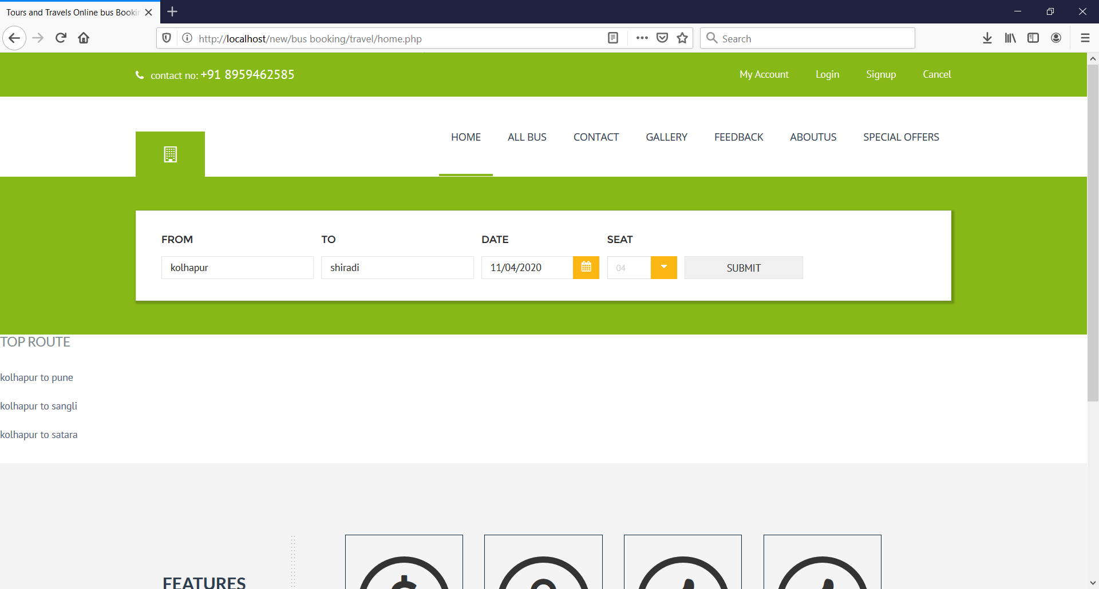

Slide 8
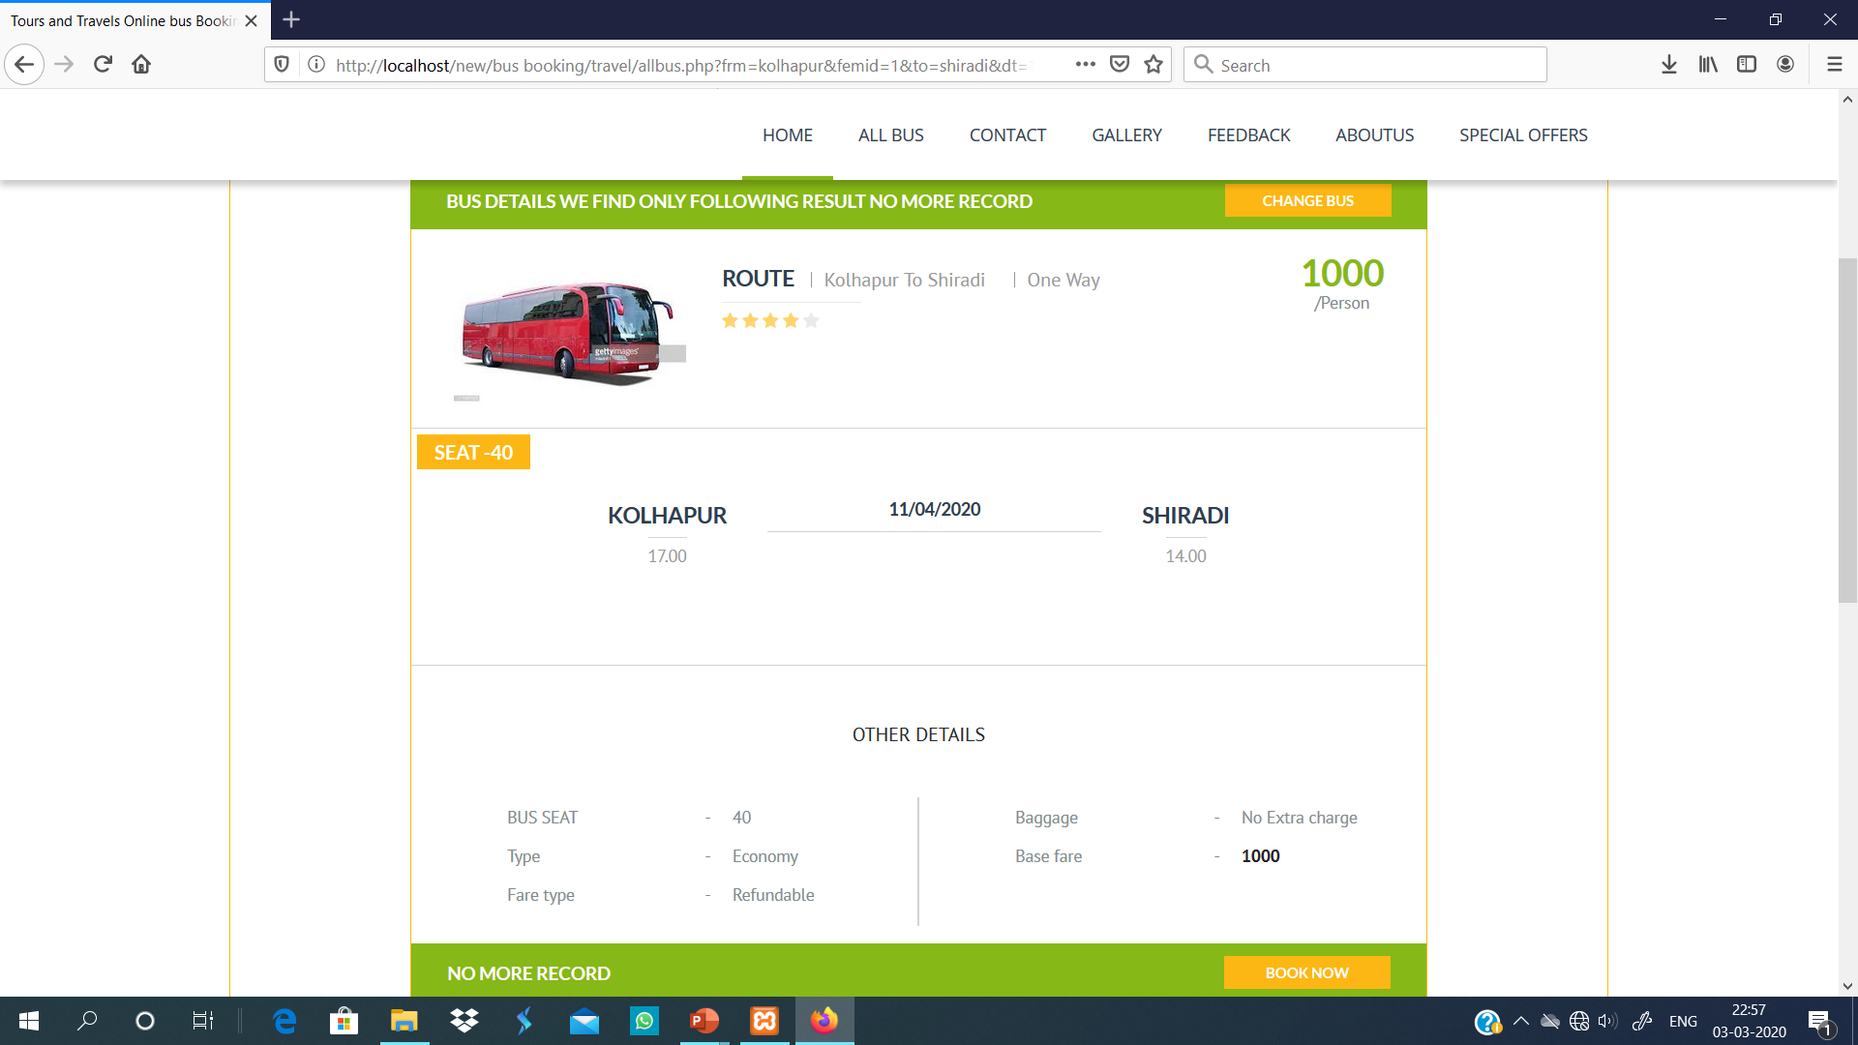

Slide 9
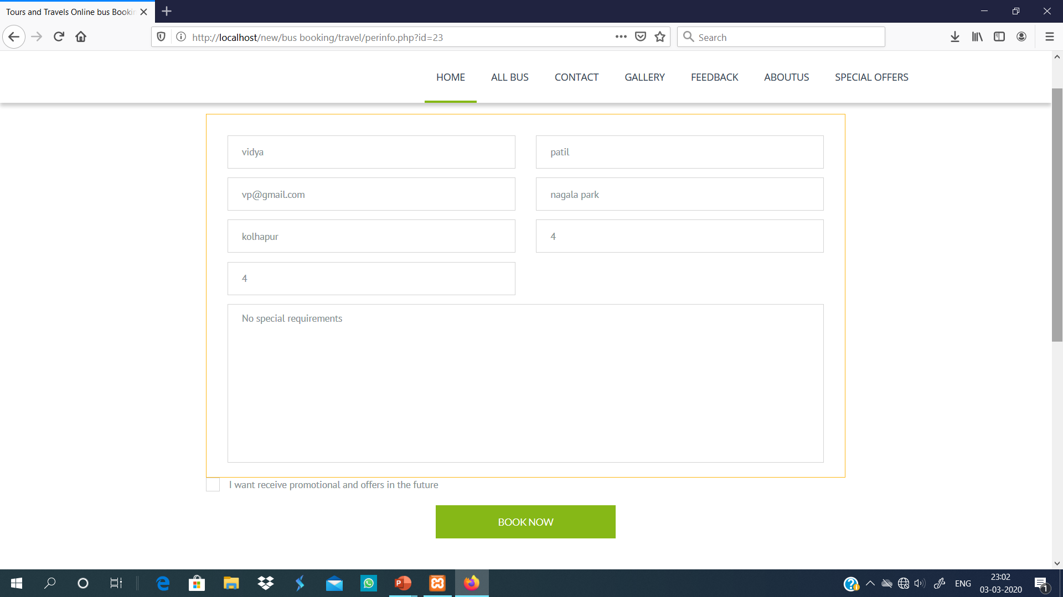

Slide 10
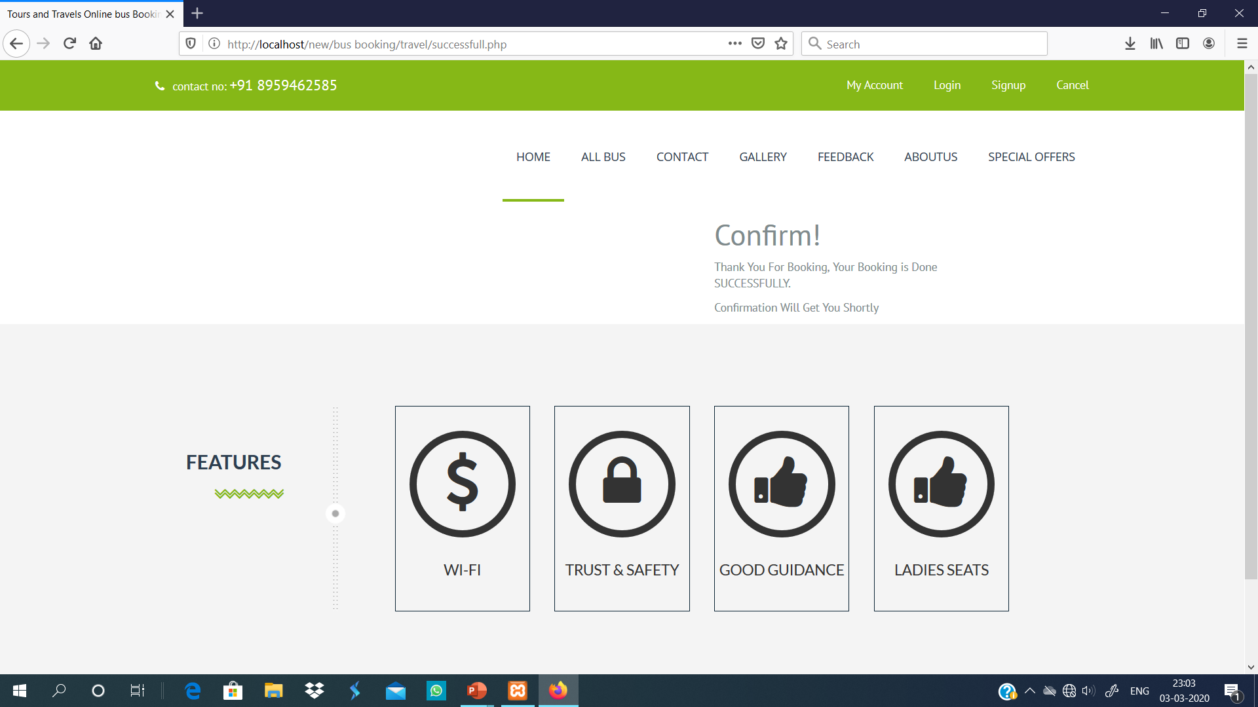

Slide 11
System Diagrams

Slide 12
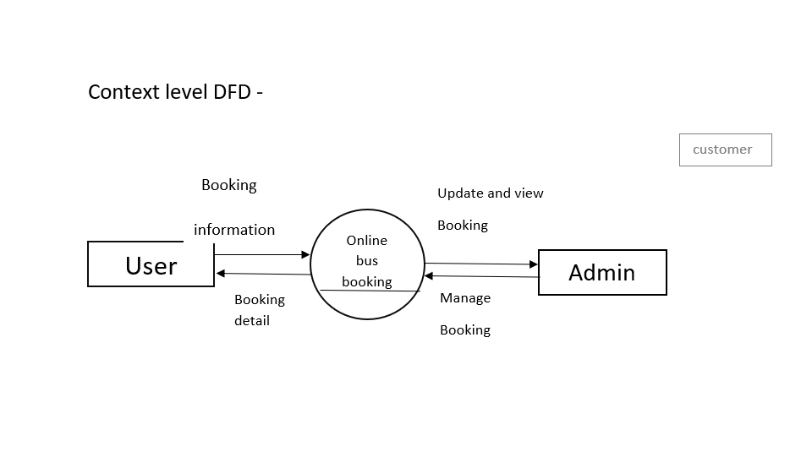

Slide 13
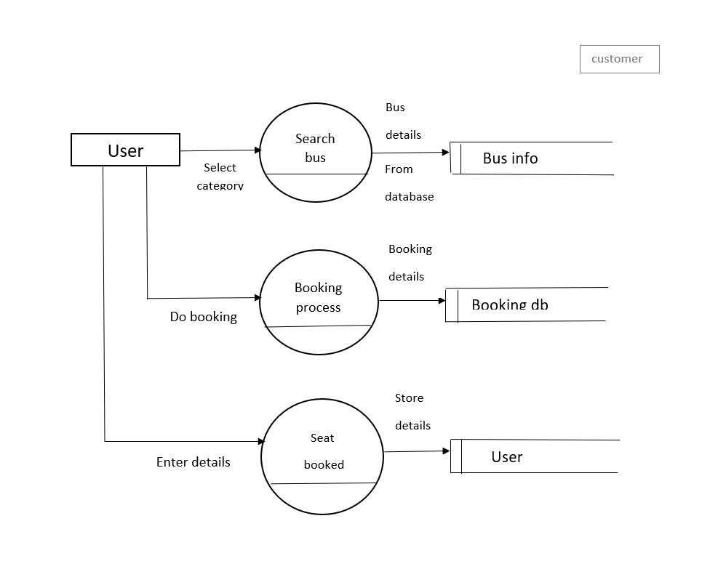

Slide 14
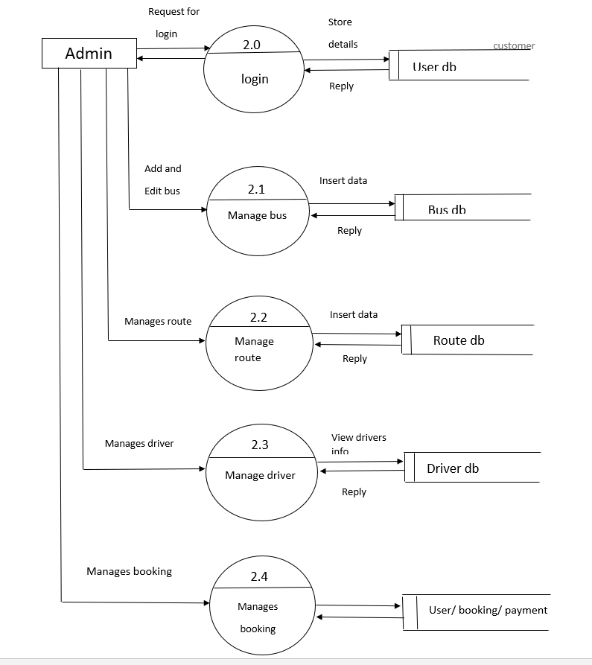

Slide 15
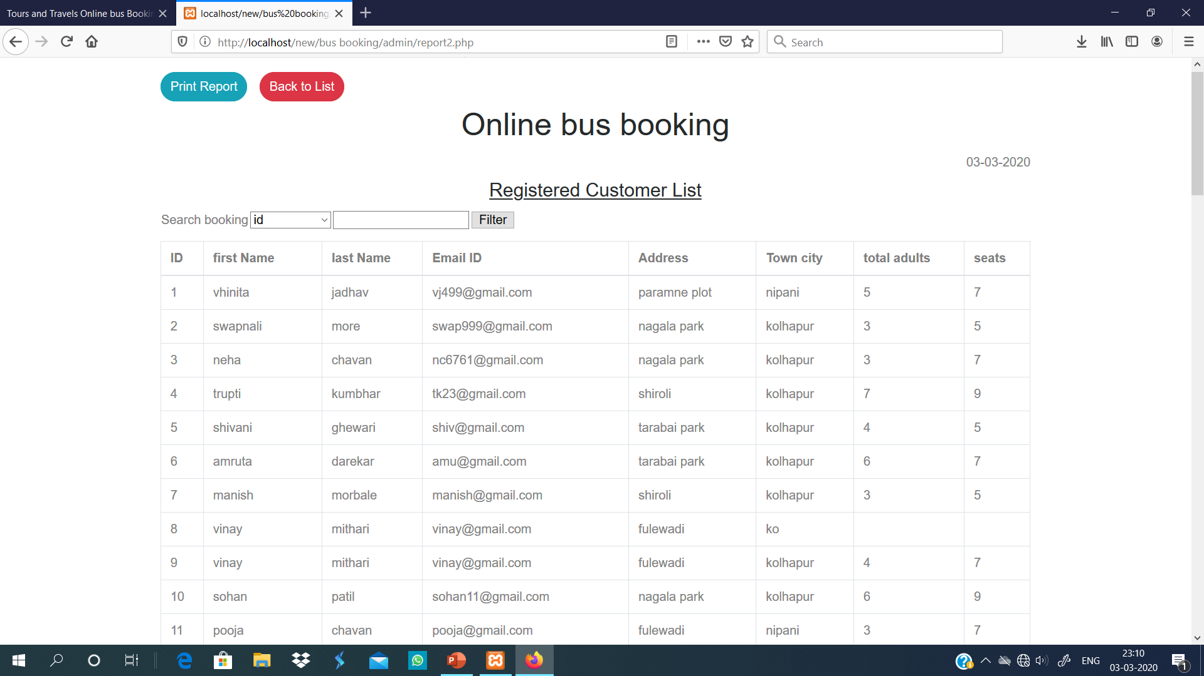
Report

Slide 16
Conclusion
In our project work, and attempt has been made to develop a bus booking based website. We develop this project that helps the people and make them aware so that they can know any booking information. To establish this website we use various methodologies. To develop this project we have faced many problems but we hardly tried to develop this project. Our supervisor helps us by giving his valuable opinion, decision and time.

Slide 17
Bibliography
www.w3school.com
www.fontwesome.com
www.google.com

Slide 18
Thank you…

